Slide 1


Kotam Phaniraj Netha
5 April 2024

Slide 2

Outline
Executive Summary
Introduction
Methodology
Results
Conclusion
Appendix

Slide 3
Executive Summary
Summary of methodologies
Data collection through API
Data collection with Web Scraping
Data wrangling
EDA with SQL
EDA with Data visualization
Interactive Visual Analytics with Folium
Machine Learning Prediction
Summary of all results
Exploratory Data Analysis results
Predictive Analytics results

Slide 4
Introduction
Project background and context
SpaceX, a leader in the space industry, strives to make space travel affordable for everyone. Its accomplishments include sending spacecraft to the international space station, launching a satellite constellation that provides internet access and sending manned missions to space. SpaceX can do this because the rocket launches are relatively inexpensive ($62 million per launch) due to its novel reuse of the first stage of its Falcon 9 rocket. Other providers, which are not able to reuse the first stage, cost upwards of $165 million each. By determining if the first stage will land, we can determine the price of the launch. To do this, we can use public data and machine learning models to predict whether SpaceX – or a competing company – can reuse the first stage.
Explore
How payload mass, launch site, number of flights, and orbits affect first-stage landing success
Rate of successful landings over time
Best predictive model for successful landing (binary classification)

Slide 5

Section 1

Slide 6
Methodology
Executive Summary
Data collection methodology:
Data was collected using SpaceX API and Web scraping from Wikipedia
Perform data wrangling
Handling missing data, one-hot encoding, feature engineering
Perform exploratory data analysis (EDA) using visualization and SQL
Perform interactive visual analytics using Folium and Plotly Dash
Perform predictive analysis using classification models
Predict landing outcomes. Tune and evaluate models to find best models and parameters.

Slide 7
Data Collection - API
Requestdatafrom SpaceX API (rocket launch data)
Decoderesponseusing .json() and convert to a dataframe using .json_normalize()
Requestinformationabout the launches from SpaceX API using custom functions
Create dictionary from the data
Create dataframe from the dictionary
Filter dataframe to contain only Falcon 9 launches
Replace missing values of Payload Mass with calculated .mean()
Export data to csv file

Slide 8
Data Collection – Web Scraping
Request data (Falcon 9 launch data) from Wikipedia
Create BeautifulSoup object from HTML response
Extract column names from HTML table header
Collect data from parsing HTML tables
Create dictionary from the data
Create dataframe from the dictionary
Export data to csv file

Slide 9
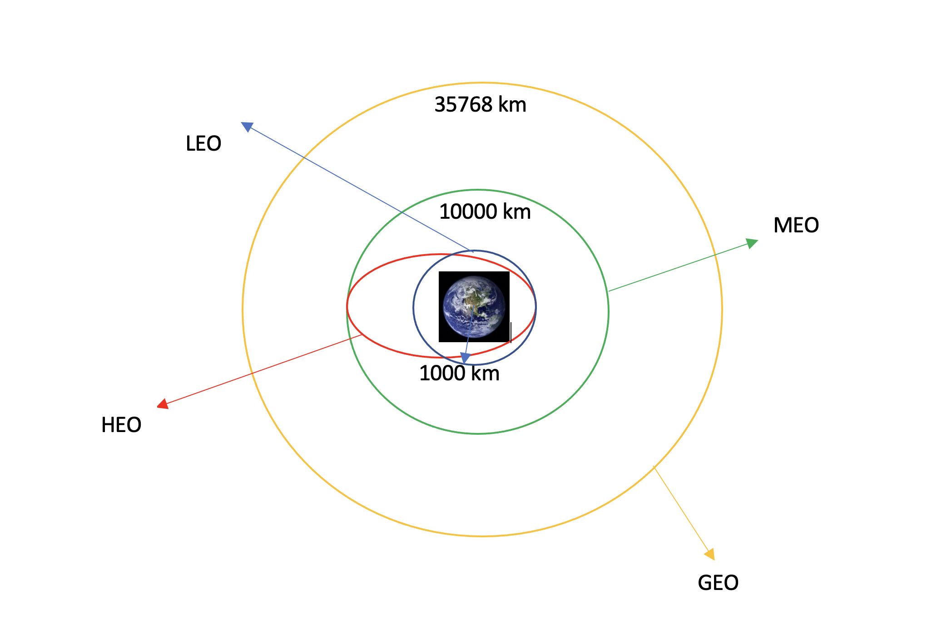
Data Wrangling
We Performed EDA and determined data labels.
Calculated number of launches for each site, and the number of occurrences of each orbit.
Created binary landing outcome column (dependent variable)

Slide 10
EDA with Data Visualization
Charts
• Flight Number vs. Payload
• Flight Number vs. Launch Site
• Payload Mass (kg) vs. Launch Site
• Payload Mass (kg) vs. Orbit type
Analysis
• View relationship by using scatter plots. The variables could be useful for
machine learning if a relationship exists
• Show comparisons among discrete categories with bar charts. Bar charts
show the relationships among the categories and a measured value

Slide 11
EDA with SQL
Display:
• Names of unique launch sites
• 5 records where launch site begins with ‘CCA’
• Total payload mass carried by boosters launched by NASA (CRS)
• Average payload mass carried by booster version F9 v1.1.
List:
• Date of first successful landing on ground pad
• Names of boosters which had success landing on drone ship and have payload mass greater than 4,000 but less than 6,000
• Total number of successful and failed missions
• Names of booster versions which have carried the max payload
• Failed landing outcomes on drone ship, their booster version and launch site for the months in the year 2015
• Count of landing outcomes between 2010-06-04 and 2017-03-20 (desc)

Slide 12
Build an Interactive Map with Folium
Markers Indicating Launch Sites
Added blue circle at NASA Johnson Space Center's coordinate with a popup label showing its name using its latitude and longitude coordinates
Added red circles at all launch sites coordinates with a popup label showing its name using its name using its latitude and longitude coordinates
Colored Markers of Launch Outcomes
Added colored markers of successful (green) and unsuccessful (red) launches at each launch site to show which launch sites have high success
rates
Distances Between a Launch Site to Proximities
Added colored lines to show distance between launch site CCAFS SLC 40 and its proximity to the nearest coastline, railway, highway, and city

Slide 13
Build a Dashboard with Plotly Dash
Dropdown List with Launch Sites
Allow user to select all launch sites or a certain launch site
Pie Chart Showing Successful Launches
Allow user to see successful and unsuccessful launches as a percent of the total
Slider of Payload Mass Range
Allow user to select payload mass range
Scatter Chart Showing Payload Mass vs. Success Rate by Booster Version
Allow user to see the correlation between Payload and Launch Success

Slide 14
Predictive Analysis (Classification)
Create NumPy array from the Class column
Standardize the data with StandardScaler. Fit and transform the data.
Split the data using train_test_split
Create a GridSearchCV object with cv=10 for parameter optimization
Apply GridSearchCV on different algorithms: logistic regression, support vector machine, decision tree, K-Nearest Neighbor.
Calculate accuracy on the test data using .score() for all models
Assess the confusion matrix for all models
Identify the best model using Jaccard_Score, F1_Score and Accuracy

Slide 15
Results
Exploratory data analysis results
Interactive analytics demo in screenshots
Predictive analysis results

Slide 16

Section 2

Slide 17
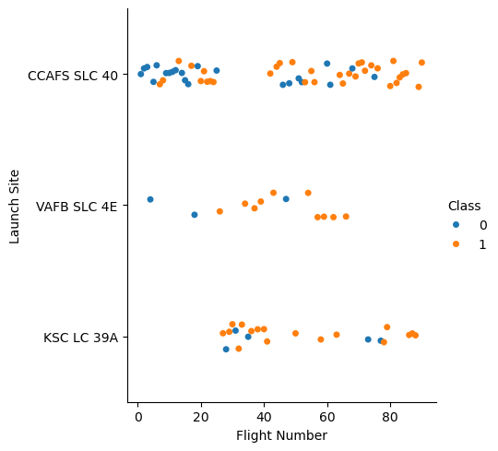
Flight Number vs. Launch Site
Earlier flights had a lower success rate (blue = fail)
Later flights had a higher success rate (orange = success)
AFB SLC 4E and KSC LC 39A have higher success rates

Slide 18
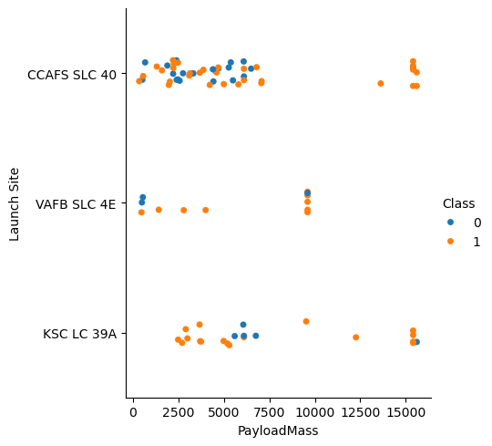
Payload vs. Launch Site
Typically, the higher the payload mass (kg), the higher the success rate
Most launces with a payload greater than 7,000 kg were successful
KSC LC 39A has a 100% success rate for launches less than 5,500 kg
VAFB SKC 4E has not launched anything greater than ~10,000 k

Slide 19
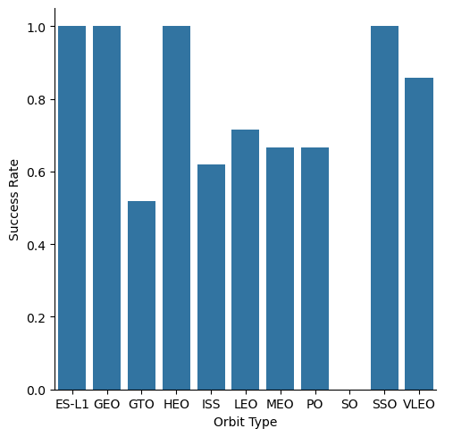
Success Rate vs. Orbit Type
100% Success Rate: ES-L1, GEO, HEO and SSO
50%-80% Success Rate: GTO, ISS, LEO, MEO, PO
0% Success Rate: SO

Slide 20
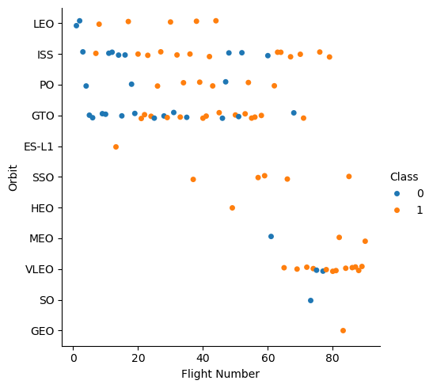
Flight Number vs. Orbit Type
The success rate typically increases with the number of flights for each orbit
This relationship is highly apparent for the LEO orbit
The GTO orbit, however, does not follow this trend

Slide 21
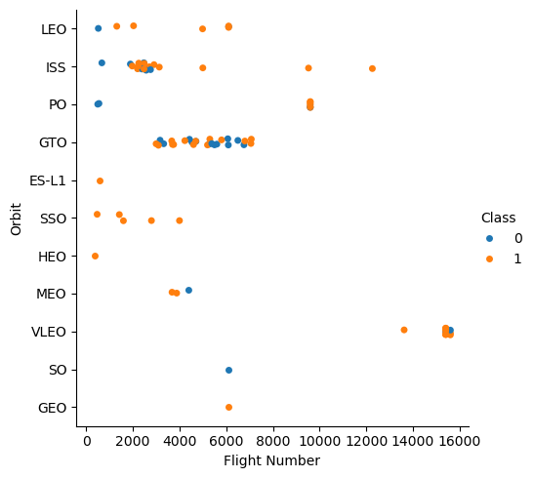
Payload vs. Orbit Type
Heavy payloads are better with LEO, ISS and PO orbits
The GTO orbit has mixed success with heavier payloads

Slide 22
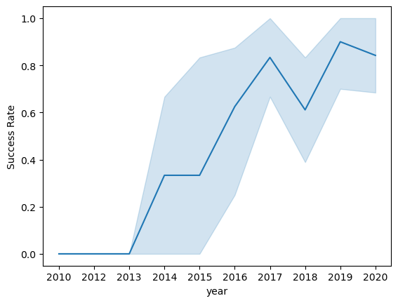
Launch Success Yearly Trend
The success rate improved from 2013-2017 and 2018-2019
The success rate decreased from 2017-2018 and from 2019-2020
Overall, the success rate has improved since 2013

Slide 23
All Launch Site Names

Slide 24
Launch Site Names Begin with 'CCA'
Find 5 records where launch sites begin with `CCA`
Present your query result with a short explanation here

Slide 25
Total Payload Mass
Calculate the total payload carried by boosters from NASA
Present your query result with a short explanation here

Slide 26
Average Payload Mass by F9 v1.1
Calculate the average payload mass carried by booster version F9 v1.1
Present your query result with a short explanation here

Slide 27
First Successful Ground Landing Date
Find the dates of the first successful landing outcome on ground pad
Present your query result with a short explanation here

Slide 28
Successful Drone Ship Landing with Payload between 4000 and 6000
List the names of boosters which have successfully landed on drone ship and had payload mass greater than 4000 but less than 6000
Present your query result with a short explanation here

Slide 29
Total Number of Successful and Failure Mission Outcomes
Calculate the total number of successful and failure mission outcomes
Present your query result with a short explanation here

Slide 30
Boosters Carried Maximum Payload
List the names of the booster which have carried the maximum payload mass
Present your query result with a short explanation here

Slide 31
2015 Launch Records
List the failed landing_outcomes in drone ship, their booster versions, and launch site names for in year 2015
Present your query result with a short explanation here

Slide 32
Rank Landing Outcomes Between 2010-06-04 and 2017-03-20
Rank the count of landing outcomes (such as Failure (drone ship) or Success (ground pad)) between the date 2010-06-04 and 2017-03-20, in descending order
Present your query result with a short explanation here

Slide 33

Section 3

Slide 34
<Folium Map Screenshot 1>
Replace <Folium map screenshot 1> title with an appropriate title
Explore the generated folium map and make a proper screenshot to include all launch sites’ location markers on a global map
Explain the important elements and findings on the screenshot

Slide 35
<Folium Map Screenshot 2>
Replace <Folium map screenshot 2> title with an appropriate title
Explore the folium map and make a proper screenshot to show the color-labeled launch outcomes on the map
Explain the important elements and findings on the screenshot

Slide 36
<Folium Map Screenshot 3>
Replace <Folium map screenshot 3> title with an appropriate title
Explore the generated folium map and show the screenshot of a selected launch site to its proximities such as railway, highway, coastline, with distance calculated and displayed
Explain the important elements and findings on the screenshot

Slide 37

Section 4

Slide 38
<Dashboard Screenshot 1>
Replace <Dashboard screenshot 1> title with an appropriate title
Show the screenshot of launch success count for all sites, in a piechart
Explain the important elements and findings on the screenshot

Slide 39
<Dashboard Screenshot 2>
Replace <Dashboard screenshot 2> title with an appropriate title
Show the screenshot of the piechart for the launch site with highest launch success ratio
Explain the important elements and findings on the screenshot

Slide 40
<Dashboard Screenshot 3>
Replace <Dashboard screenshot 3> title with an appropriate title
Show screenshots of Payload vs. Launch Outcome scatter plot for all sites, with different payload selected in the range slider
Explain the important elements and findings on the screenshot, such as which payload range or booster version have the largest success rate, etc.

Slide 41

Section 5

Slide 42
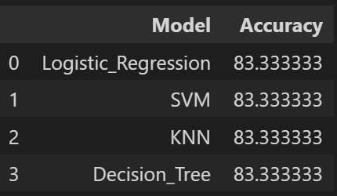
Classification Accuracy
All the models performed at about the same level and had the same scores and accuracy. This is likely due to the small dataset.
The decision tree performs better in terms of training accuracy, but it is likely to be overfitting.
The accuracy displayed here are test accuracies.

Slide 43
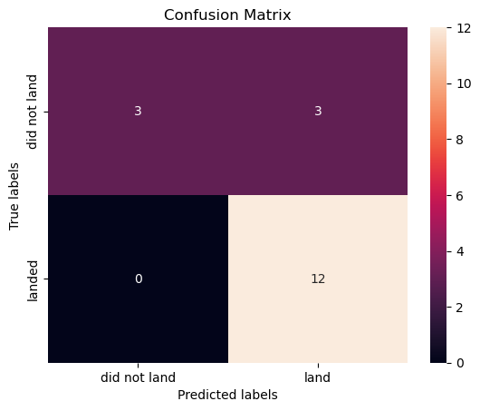
Confusion Matrix
All the confusion matrices were identical
Confusion Matrix Outputs:
12 True positive, 3 True negative, 3 False positive, 0 False Negative
Precision (P) = TP / (TP + FP) = 80%
Recall (R) = TP / (TP + FN) = 100%
F1 Score = 2*P*R/(P + R) = 89%
Accuracy = 83.4%

Slide 44
Conclusions
Model Performance: The models performed similarly on the test set with the decision tree model slightly outperforming
Equator: Most of the launch sites are near the equator for an additional natural boost - due to the rotational speed of earth - which helps save the cost of putting in extra fuel and boosters
Coast: All the launch sites are close to the coast
Launch Success: Increases over time
KSC LC-39A: Has the highest success rate among launch sites. Has a 100% success rate for launches less than 5,500 kg
Orbits: ES-L1, GEO, HEO, and SSO have a 100% success rate
Payload Mass: Across all launch sites, the higher the payload mass (kg), the higher the success rate

Slide 45


